Slide 1



AUTOMATIC LEAF INFECTION IDENTIFICATION
Team Number 11
Drishti Dhanda , IGDTUW , MCA (Sem2)
Sana Gupta , IGDTUW , MCA (Sem2)
Simran Dhiman , IGDTUW , MCA (Sem2)
Sheetal , IGDTUW , MCA (Sem2)
Ojaswini , IGDTUW , MCA (Sem2)
Name of Mentor(s)
Rishabh Kaushal

Slide 2
BACKGROUND & MOTIVATION
Being an agriculture based economy plant infections does hamper the production rate.
Humans get exhausted of monitoring the diseased plants and hence there is a necessity to monitor the plant growth everyday by using some software techniques.
Of the many modern techniques of early detection of plant diseases, image processing has become a potential tool through which not only the disease can be detected early and correctly, but also it can be quantified successfully.
.

Slide 3
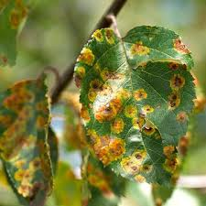
AIM
The aim is to present a model that employs a technique to extract relevant features related to the image of infected leaf along with the type of virus in order to detect and identify the type of disease that infects the plant.

Slide 4
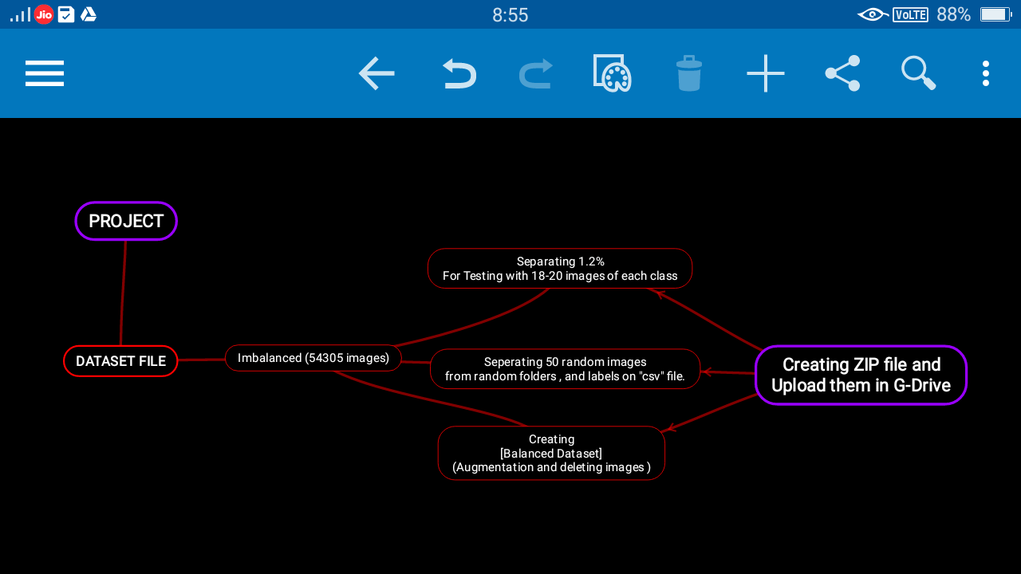

Slide 5
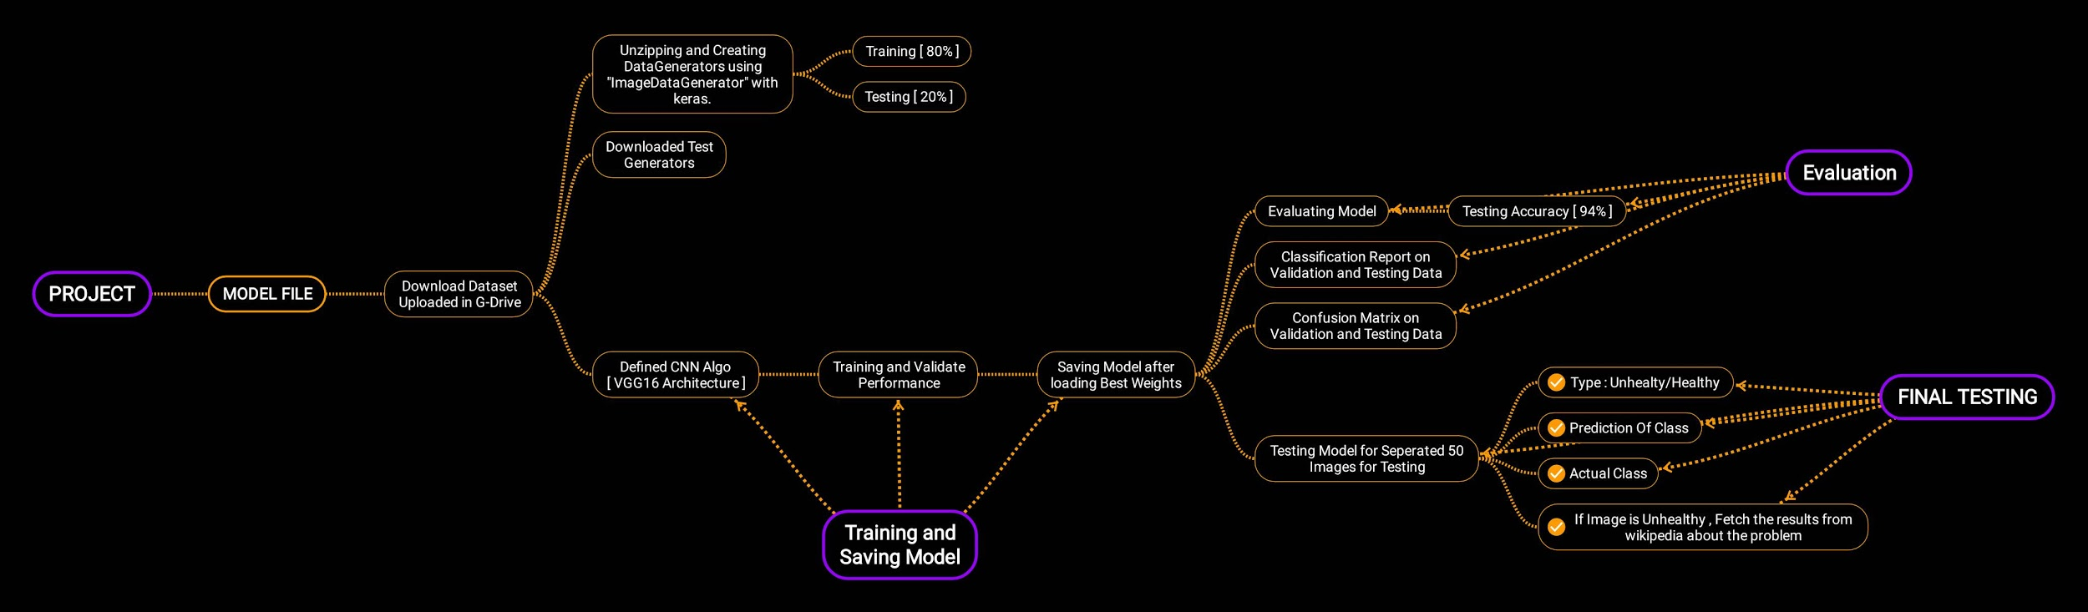

Slide 6
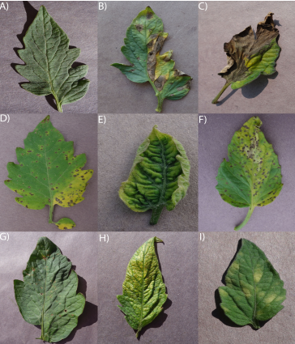
PROBLEM STATEMENT
Title : Automatic leaf infection identifier
Input: A picture of the leaf shall be shown
Output: In case it suffers from some disease that shall be identified and classified in a category.

Slide 7
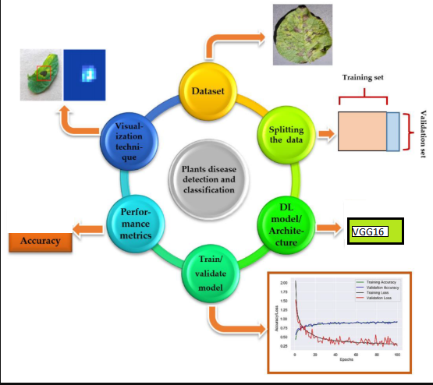
GENERAL PROPOSED LAYOUT

Slide 8
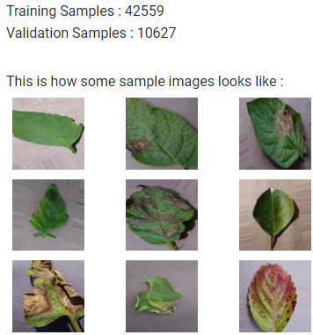
DATA COLLECTION
Images used in this model were adopted from the Plant_Leaf_diseases dataset.
URL of datasource- https://github.com/spMohanty/PlantVillage-Dataset
This dataset comprises healthy or diseased leaf images classified into 38 labels ( 53816 images)
Images were split into training, validation, and test datasets with Training Samples : 42559 ; Validation Samples : 10627
most images contain complex backgrounds, which ensures the high generalization performance of the approach.
Finally, all diseased images in the dataset are annotated manually.

Slide 9
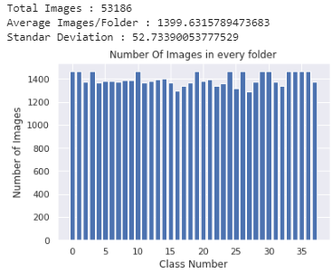
2) DATA AUGMENTATION
The purpose of applying augmentation is to increase the dataset and introduce slight distortion to the images which helps in reducing overfitting during the training stage.
Techniques used for data augmentation operations are rotation transformations, horizontal and vertical flips, and intensity disturbance, which include disturbances of brightness, sharpness and contrast
BALANCED DATASET WITH AUGMENTATION
https://colab.research.google.com/drive/1AGdqd6c9z2kUiZP7J8gE5rg7YQZ_IKiC?usp=sharing

Slide 10
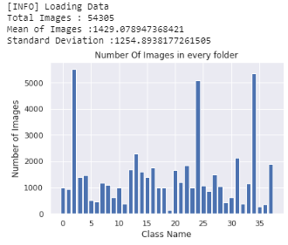
3) DATA VISUALIZATION
ORIGINAL IMBALANCED DATASET
BALANCED DATASET WITH AUGMENTATION

Slide 11
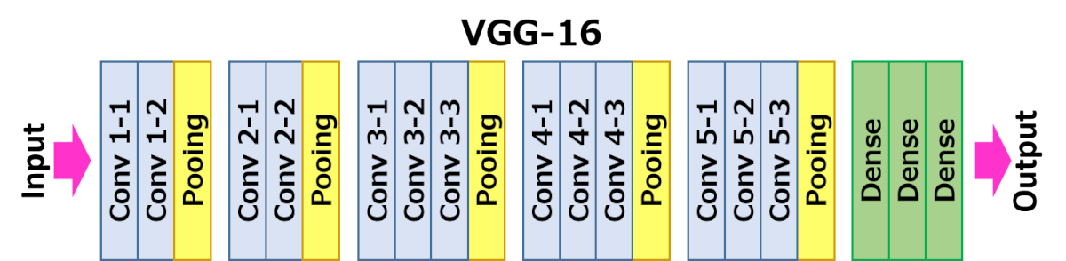
4) CNN ARCHITECTURE
We are using VGG16 for this project and using some pretrained vgg16 kernels
VGG16 is the Keras model of the 16-layer network .
VGG16 architecture has 13 convolution layers stacked together designed for image classification.

Slide 12
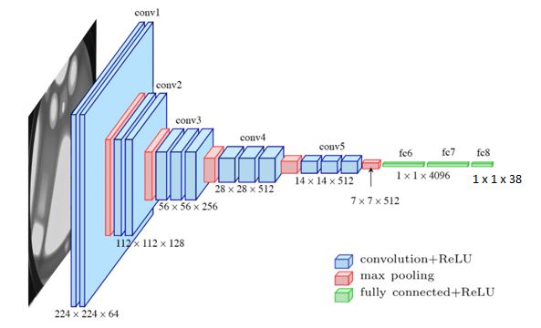
Single image in Blocks of VGG ,
Having Relu as an activation function

Slide 13
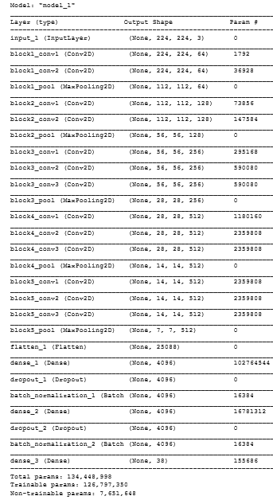
The Visual Geometry Group 16 (VGG16) model has the capability to learn more complex features as more convolution layers are in the stack with smaller filter sizes.
The summary of the model is shown on the right side
Challenges Of VGG 16:
It is very slow to train.
The size of VGG-16 trained weights quite large around 500MB - 1GB. So, it takes quite a lot of disk space .

Slide 14
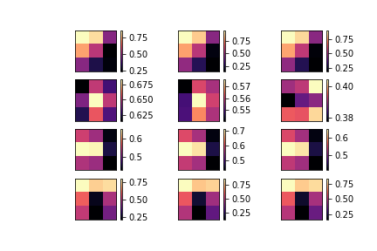
5) VISUALIZATION of CNN LAYER
The convolution layers act as an automated feature extractor that extracts pattern for discriminating each disease class.
Initial convolution layers learn simple features such as edges which combine these features in the later convolution layers to form complex features.
Each convolution layer is generally followed by a non-linear activation layer, Rectified Linear Unit (ReLU) to introduce uncertainty.
R
G
B
Random Filters of Block 1 conv 1

Slide 15
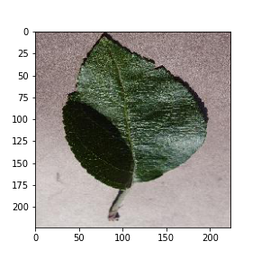
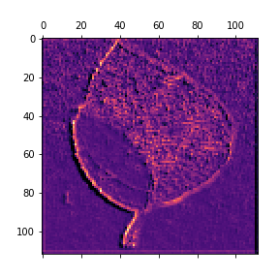
Sample Image put into CNN layer for visualization.
Sample Image multiplied with 1st conv 1st RGB filter and activated by Relu function.
Notes:
nn

Slide 16
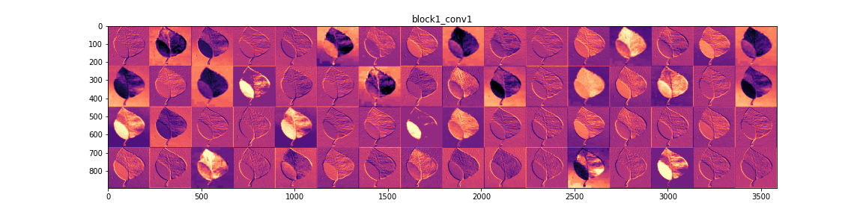
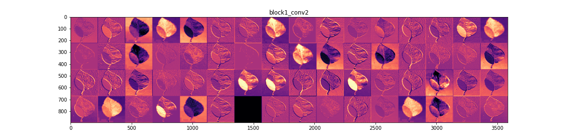
BLOCK 1 : Conv1 , Conv2 (64 filters)

Slide 17
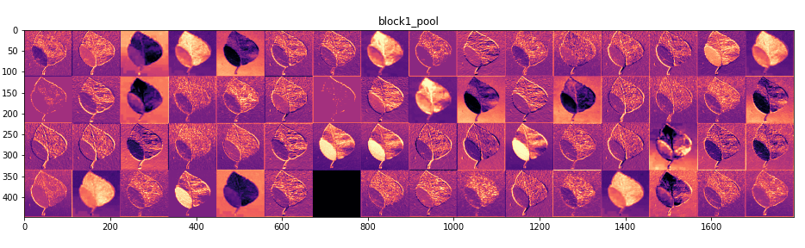
BLOCK 1 : MaxPool

Slide 18
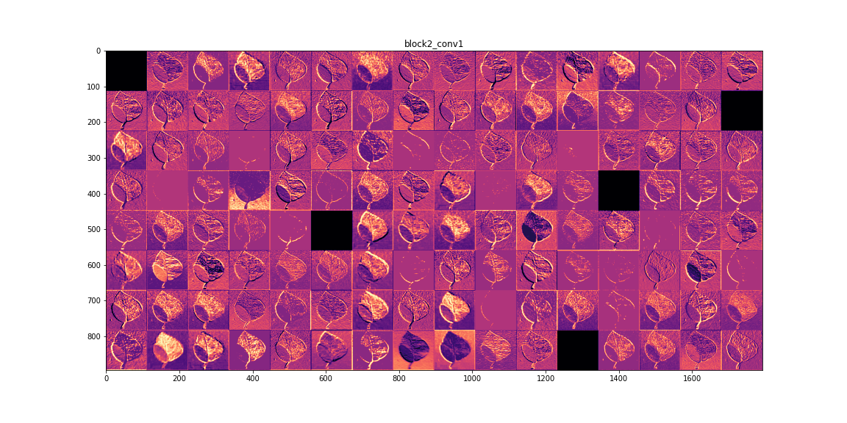
BLOCK 2 : Conv1(128 filters with RELU activation & Dropouts)

Slide 19
BLOCK 3 : Conv 1 ( 256 filters , Relu Activation , Dropouts )

Slide 20
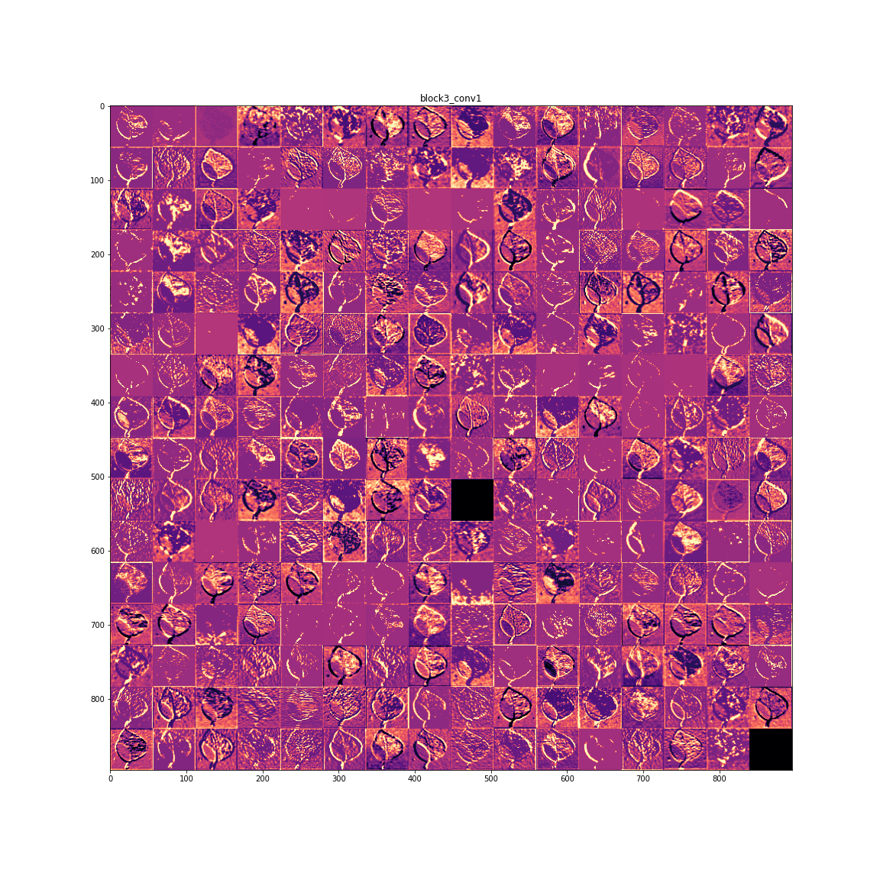

Slide 21
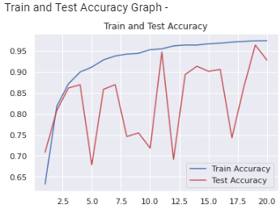
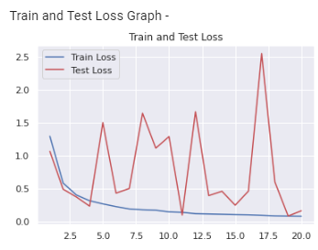
6) EXPERIMENTAL RESULTS AND ANALYSES
Results of Accuracy and Loss on Training and Validation

Slide 22
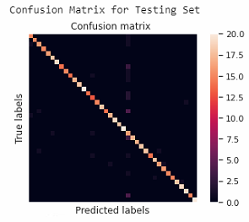
CONFUSION MATRIX
It shows the confusion matrix of the final test results.
The lighter the color in the visualization results, the higher the prediction accuracy of the model in the corresponding class.
All correct predictions are on the diagonal and all incorrect predictions are off the diagonal.
Hence, the classes have confused the detecting system can be conveniently and intuitively identified.
.

Slide 23
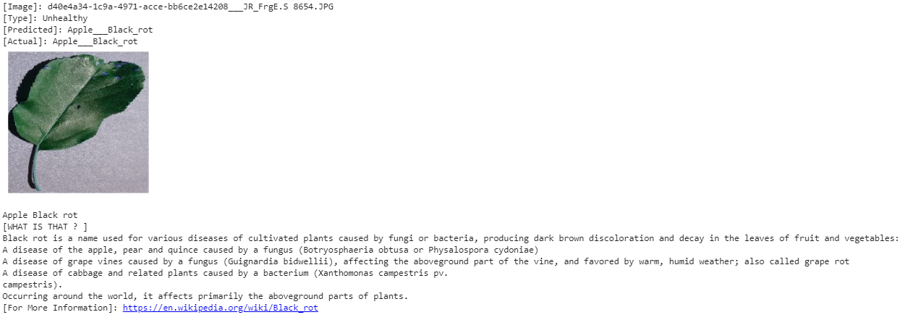
7) OUTPUT OF THE MODEL
To do the the predictions on the trained model,we
loaded the best saved model
preprocessed the image
passed the image to the model for output

Slide 24
CONCLUSION
The approach is based on improved convolutional neural networks for leaf diseases.
The deep-learning-based approach can automatically extract the discriminative features of the diseased leaf images and detect the type of virus(or disease) with high accuracy in real time.
94.04% accuracy on Testing Pictures ( 671 pictures to test )

Slide 25
Hence, the proposed model is fully capable of real-time detection of plant leaf diseases.
The results demonstrate that the proposed VGG16 model can detect the type of plant leaf disease with high accuracy in real time and provides a feasible solution for the real-time detection of leaf diseases.

Slide 26
REFERENCES
https://www.mdpi.com/2223-7747/8/11/468/htm
https://ieeexplore.ieee.org/stamp/stamp.jsp?arnumber=8706936
https://poloclub.github.io/cnn-explainer/
https://github.com/spMohanty/PlantVillage-Dataset
https://dl.acm.org/doi/abs/10.1145/3371158.3371196?casa_token=5okgbwLgH0AAAAAA:4S89QxupzVNZM7dGb3UH3dTXa8jmhk8rN4O6P6CtLiNFLYHeb8TTa0R8antPTSMteLatk2ZM-75N
https://spj.sciencemag.org/journals/plantphenomics/2019/9237136/#abstract

Slide 27


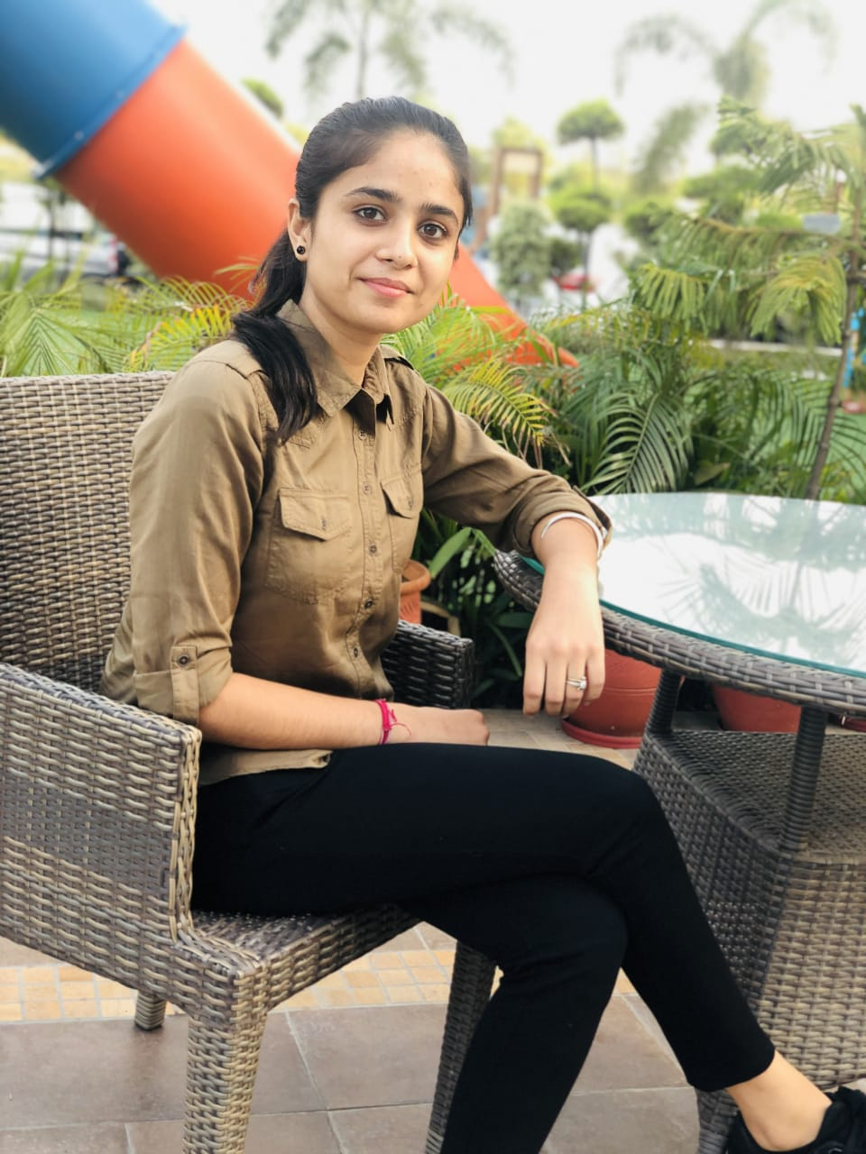


THANKYOU
CONTRIBUTORS :
SANA GUPTA
SHEETAL
SIMRAN DHIMAN
DRISHTI DHANDA
OJASWINI BHANDARI

